Slide 1
Grover vs. Cryptography : Is it Safe?
Team. SuperTangle
Notes:
안녕하세요

Slide 2
SuperTnagle’s Goal
Backgrounds
Quantum key search
Results
Conclusion

Slide 3
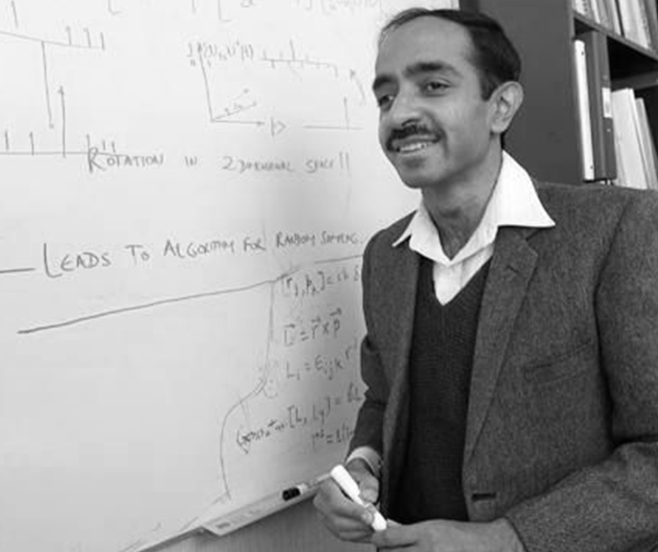

SuperTangle's Goal
V S
Grover vs. Cryptography

Slide 4
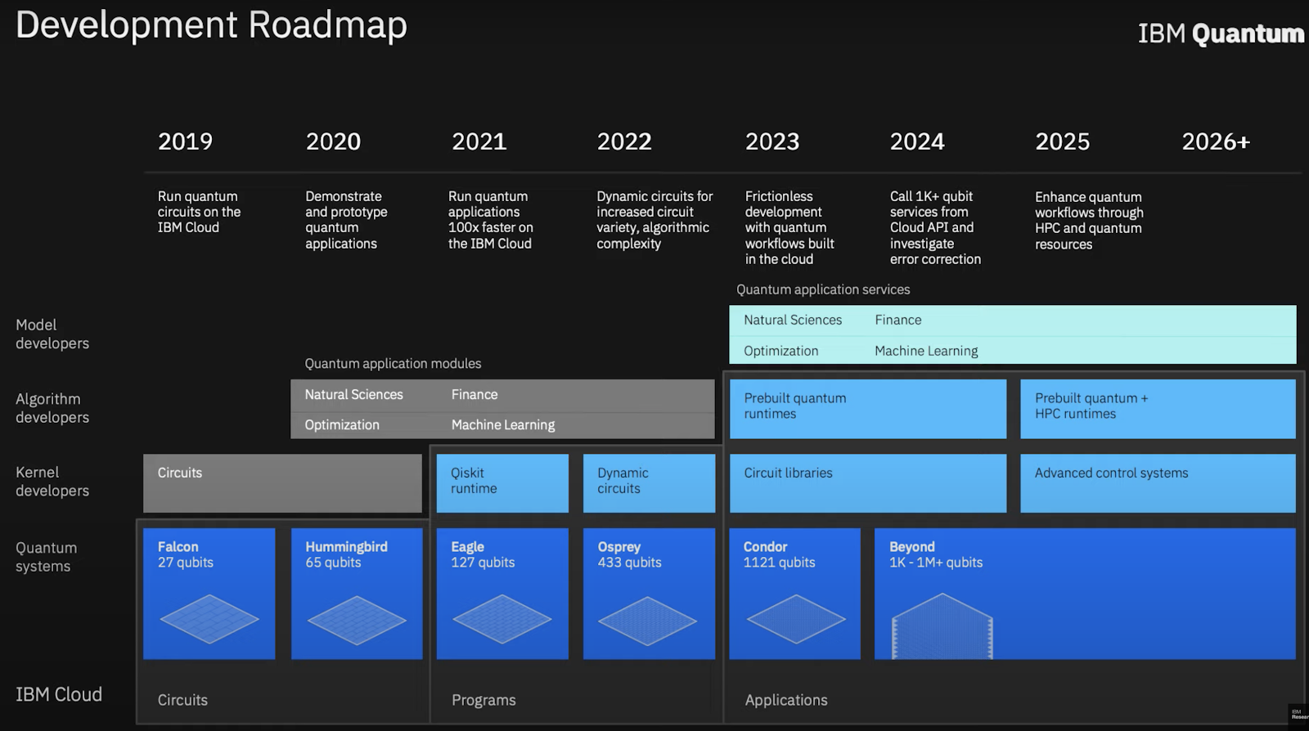
IBM Quantum Roadmap

Slide 5
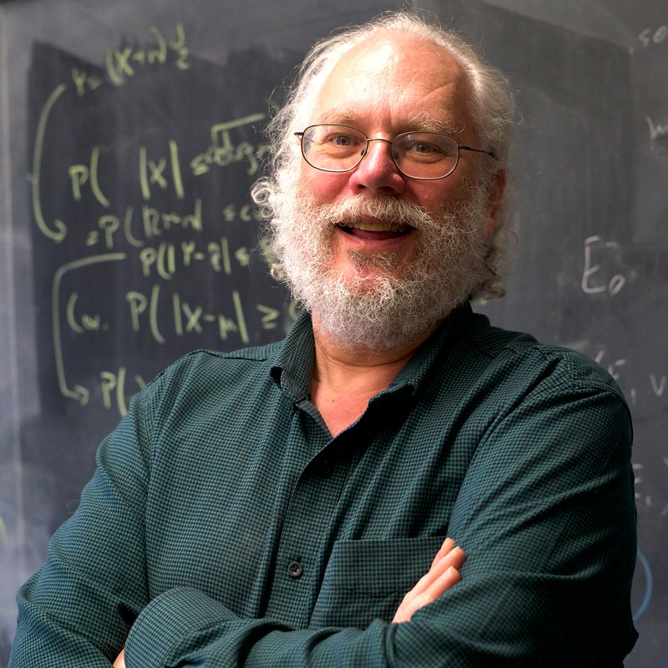
Quantum Algorithms
Shor Algorithm
RSA, ECC(public key cryptography system) based on the difficulty of Factorization, Discrete logarithmic are no longer available.
Peter. Shor

Slide 6
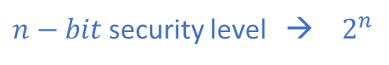
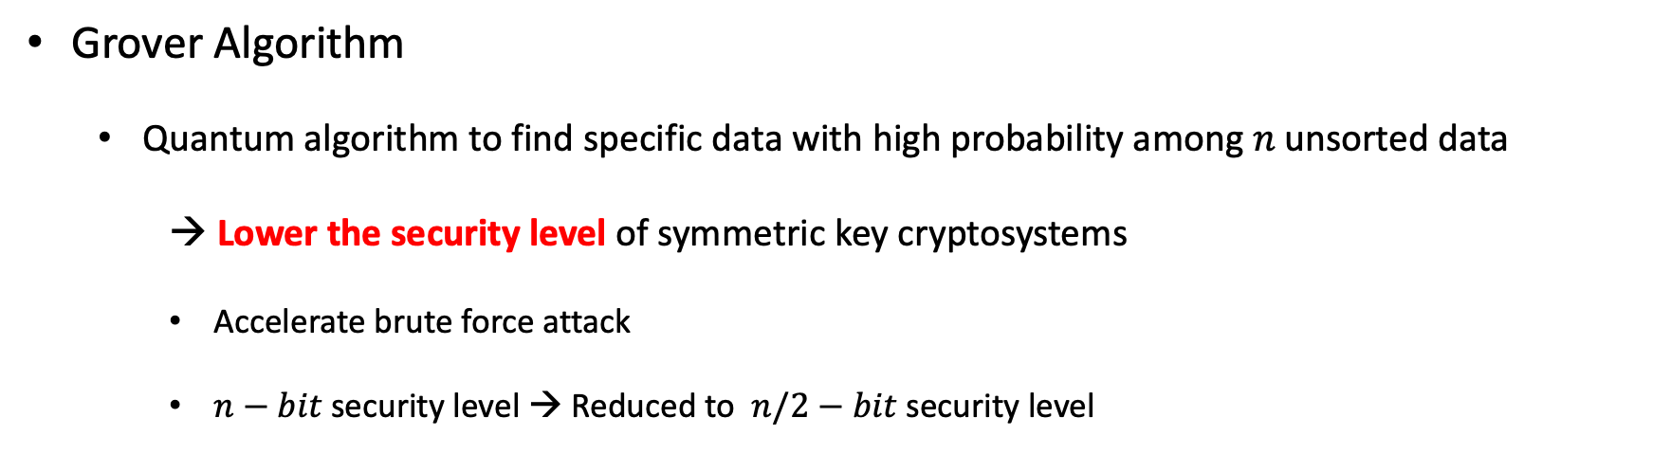
Quantum Algorithms
Grover Algorithm
Quantum algorithm to find specific data with high probability among 𝑛 unsorted data
→ Lower the security level of symmetric key cryptosystems
Accelerate brute force attack
$n−bit$security level → Reduced to $n/2−bit$security level
*
$n−bit$security level → $2^{n}$
searches for secret key

Slide 7
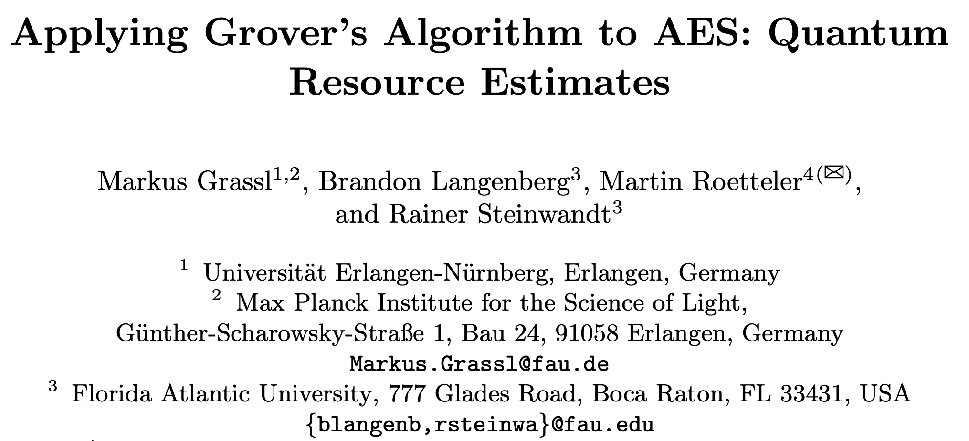
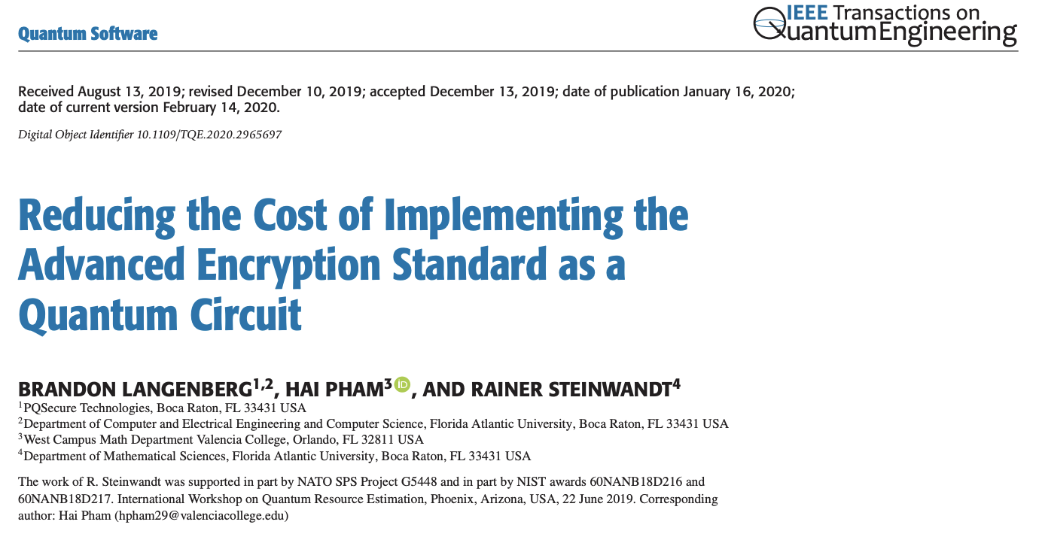
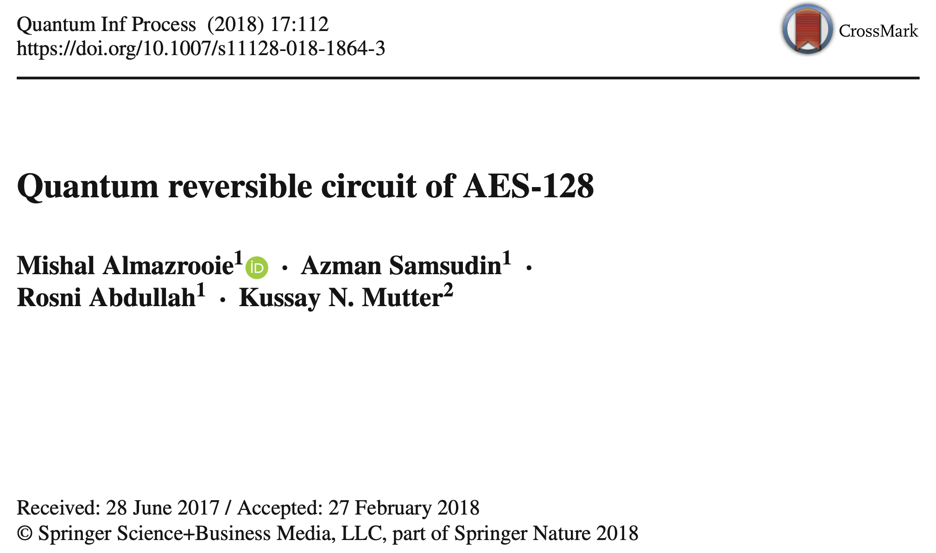
Research Trends
Quantum Implementation for AES

Slide 8
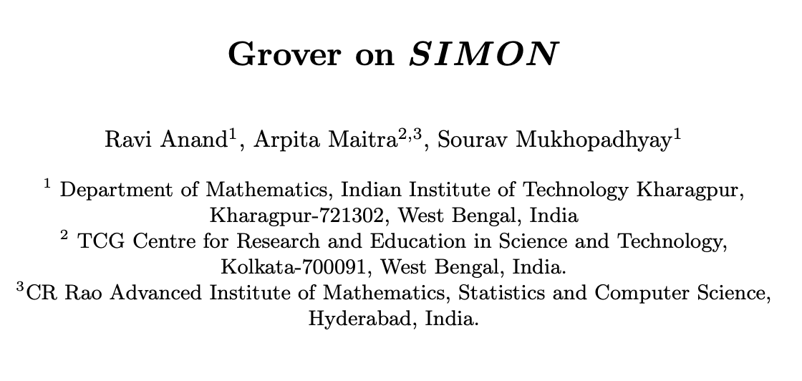
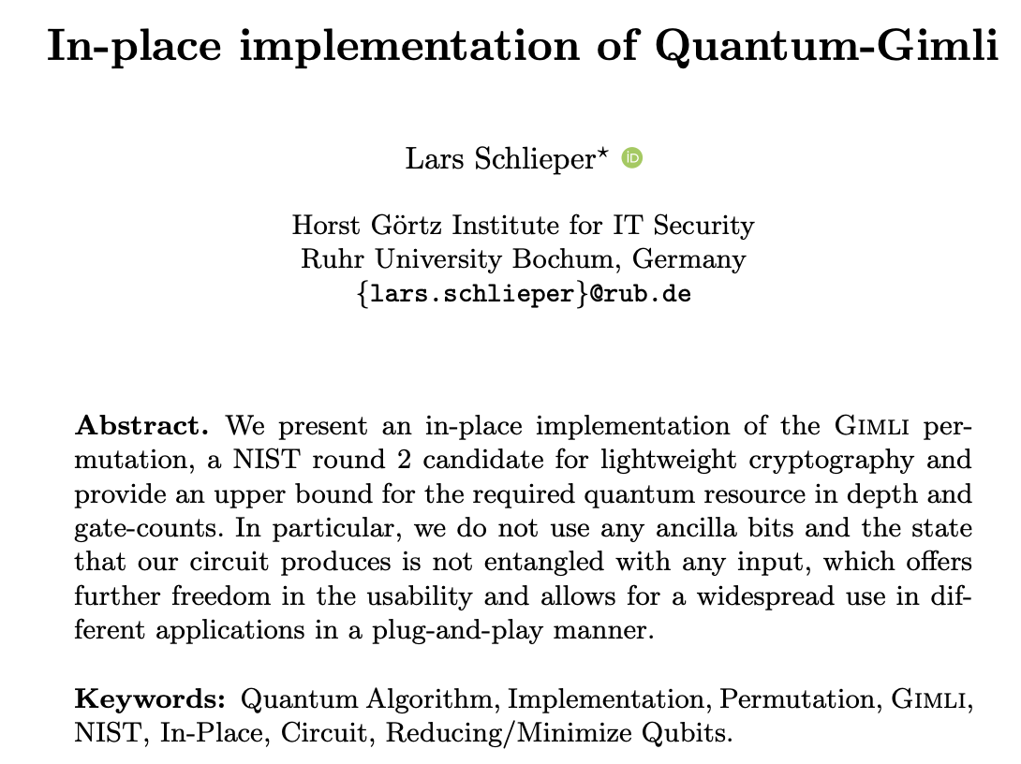
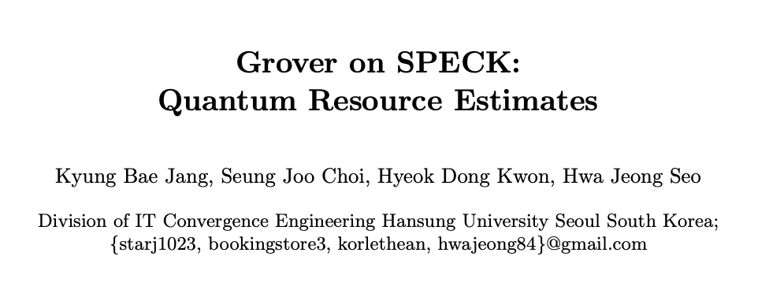
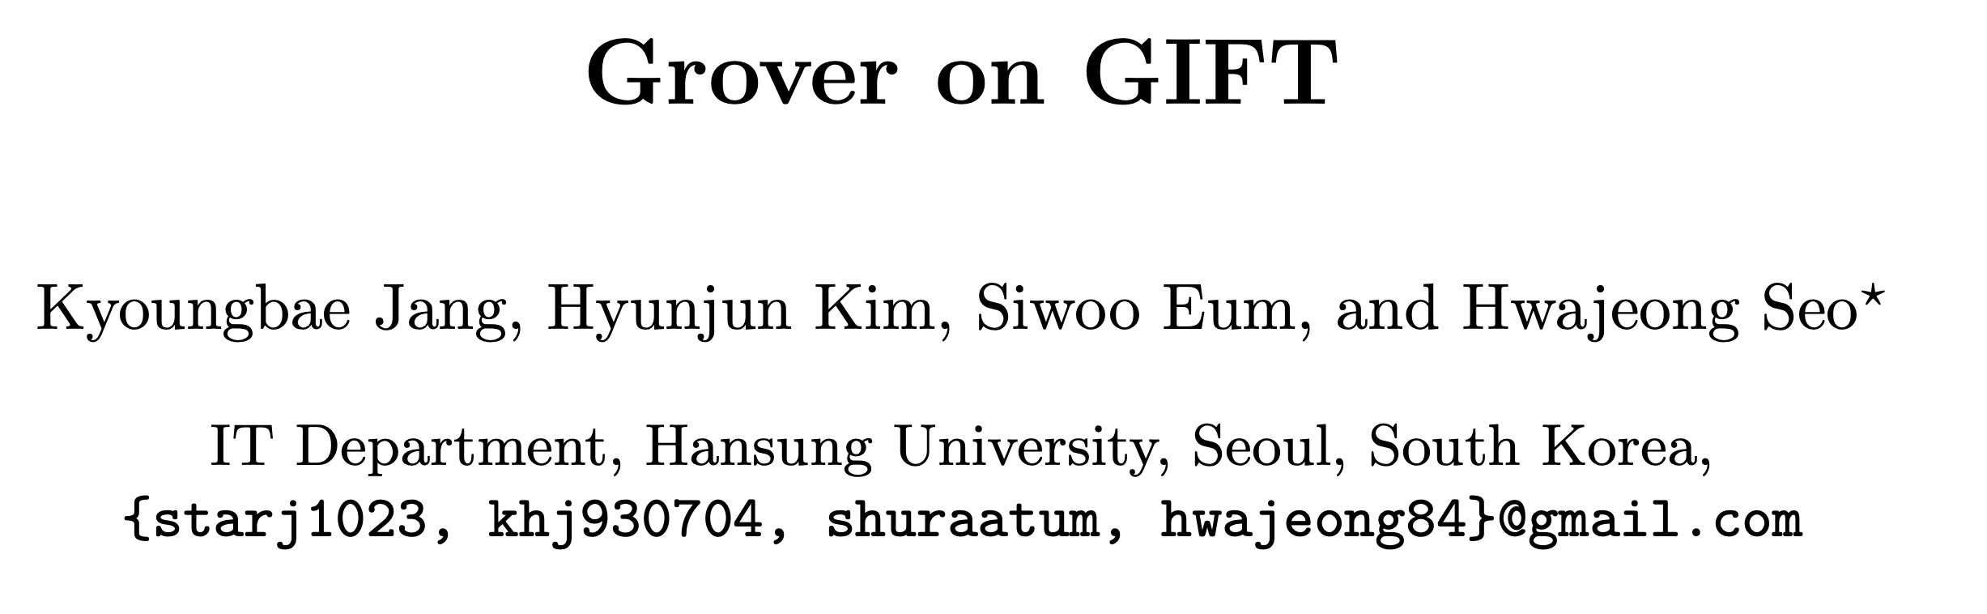
Research Trends

Slide 9
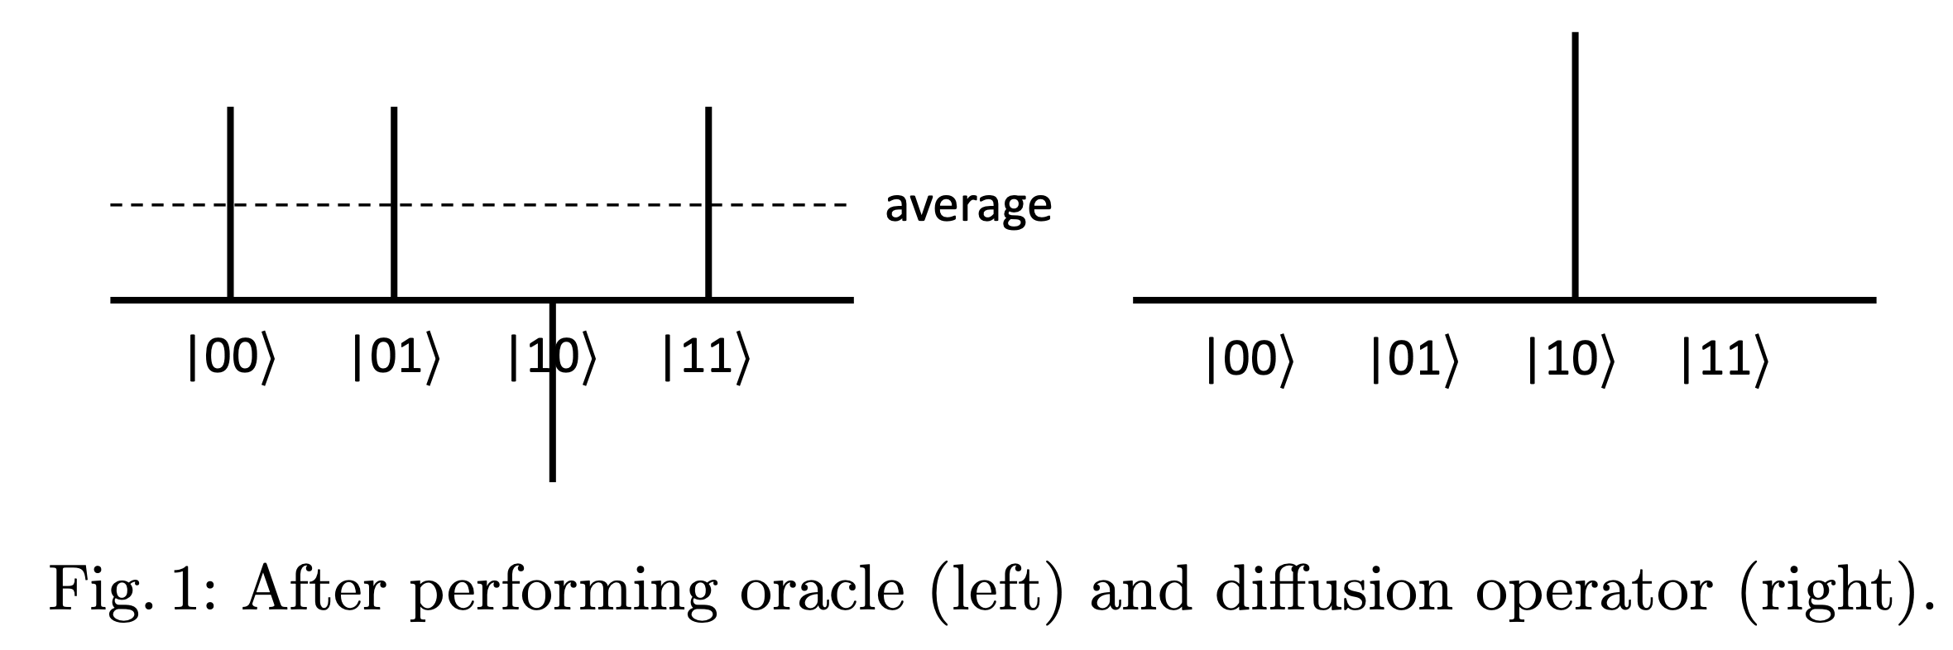
Grover’s Algorithm
Grover Algorithm
Oracle returns solution
Diffusion operator amplifies the amplitude of the solution returned by Oracle
Average amplitude— ( Each of amplitude —Average amplitude)

Slide 10
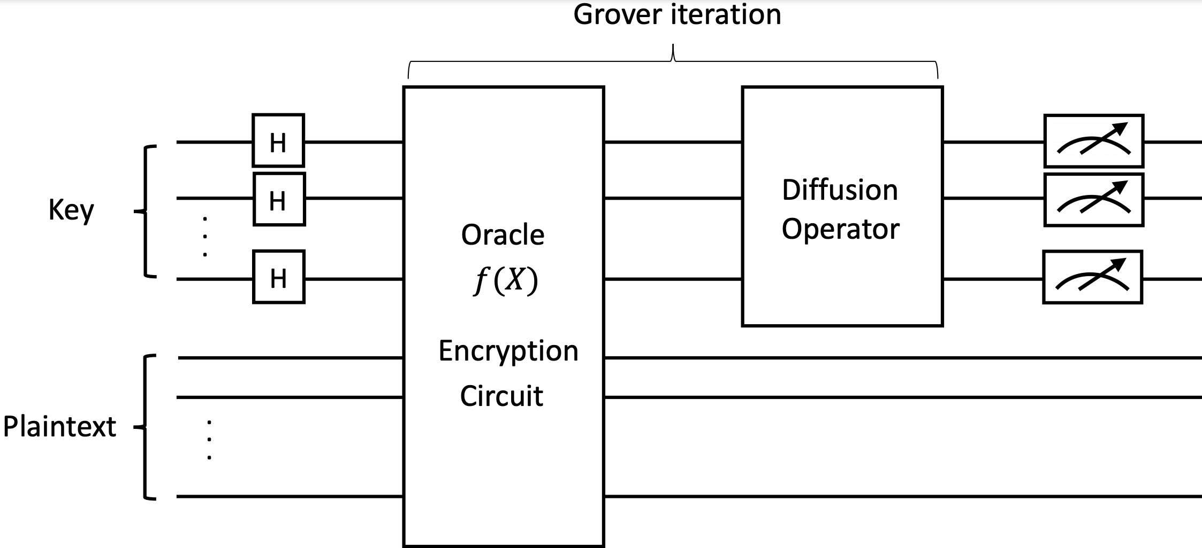
Quantum key search using Grover’s algorithm

Slide 11
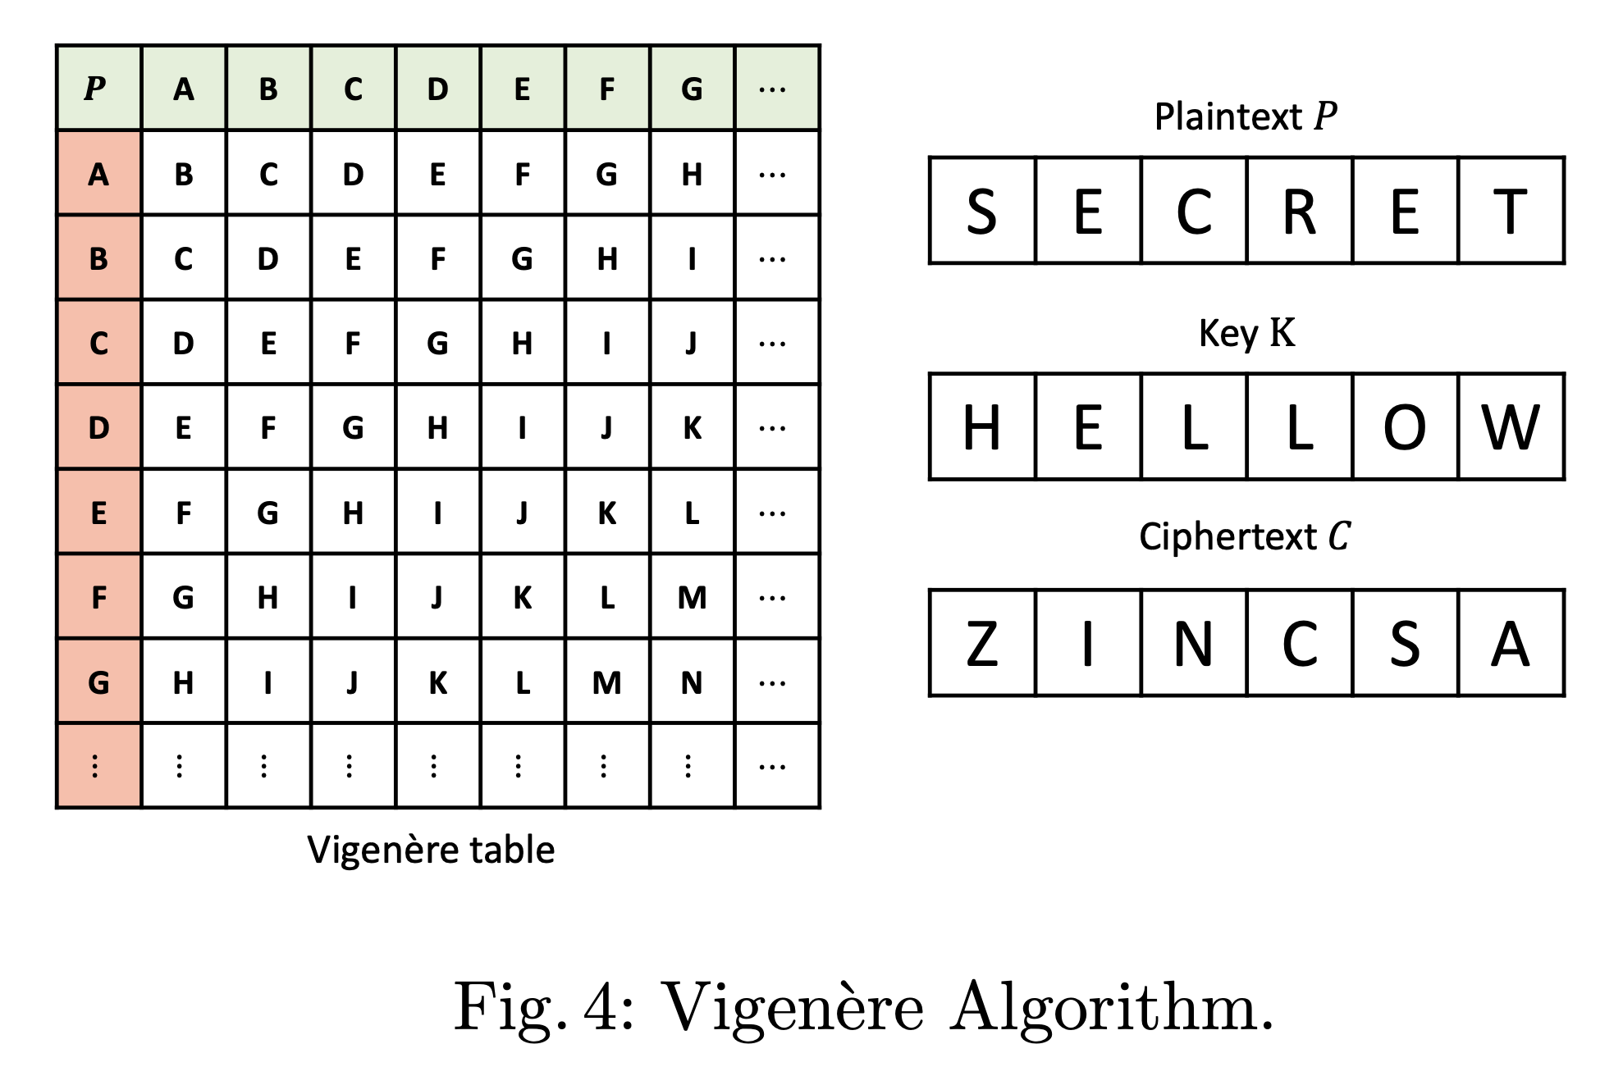
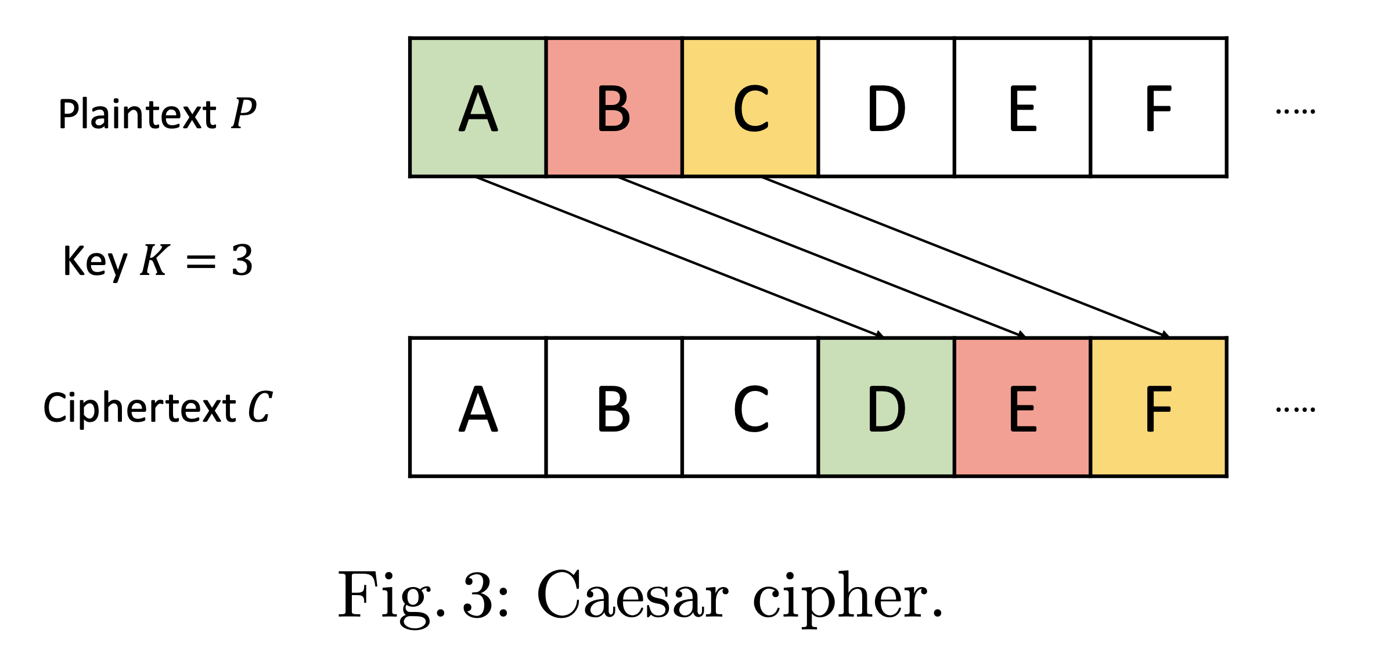
Target algorithms
Caesar, Vigenere

Slide 12
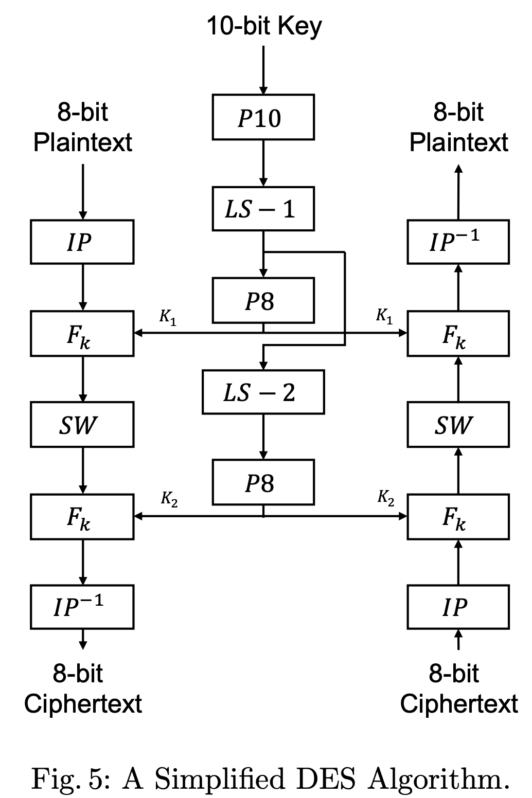
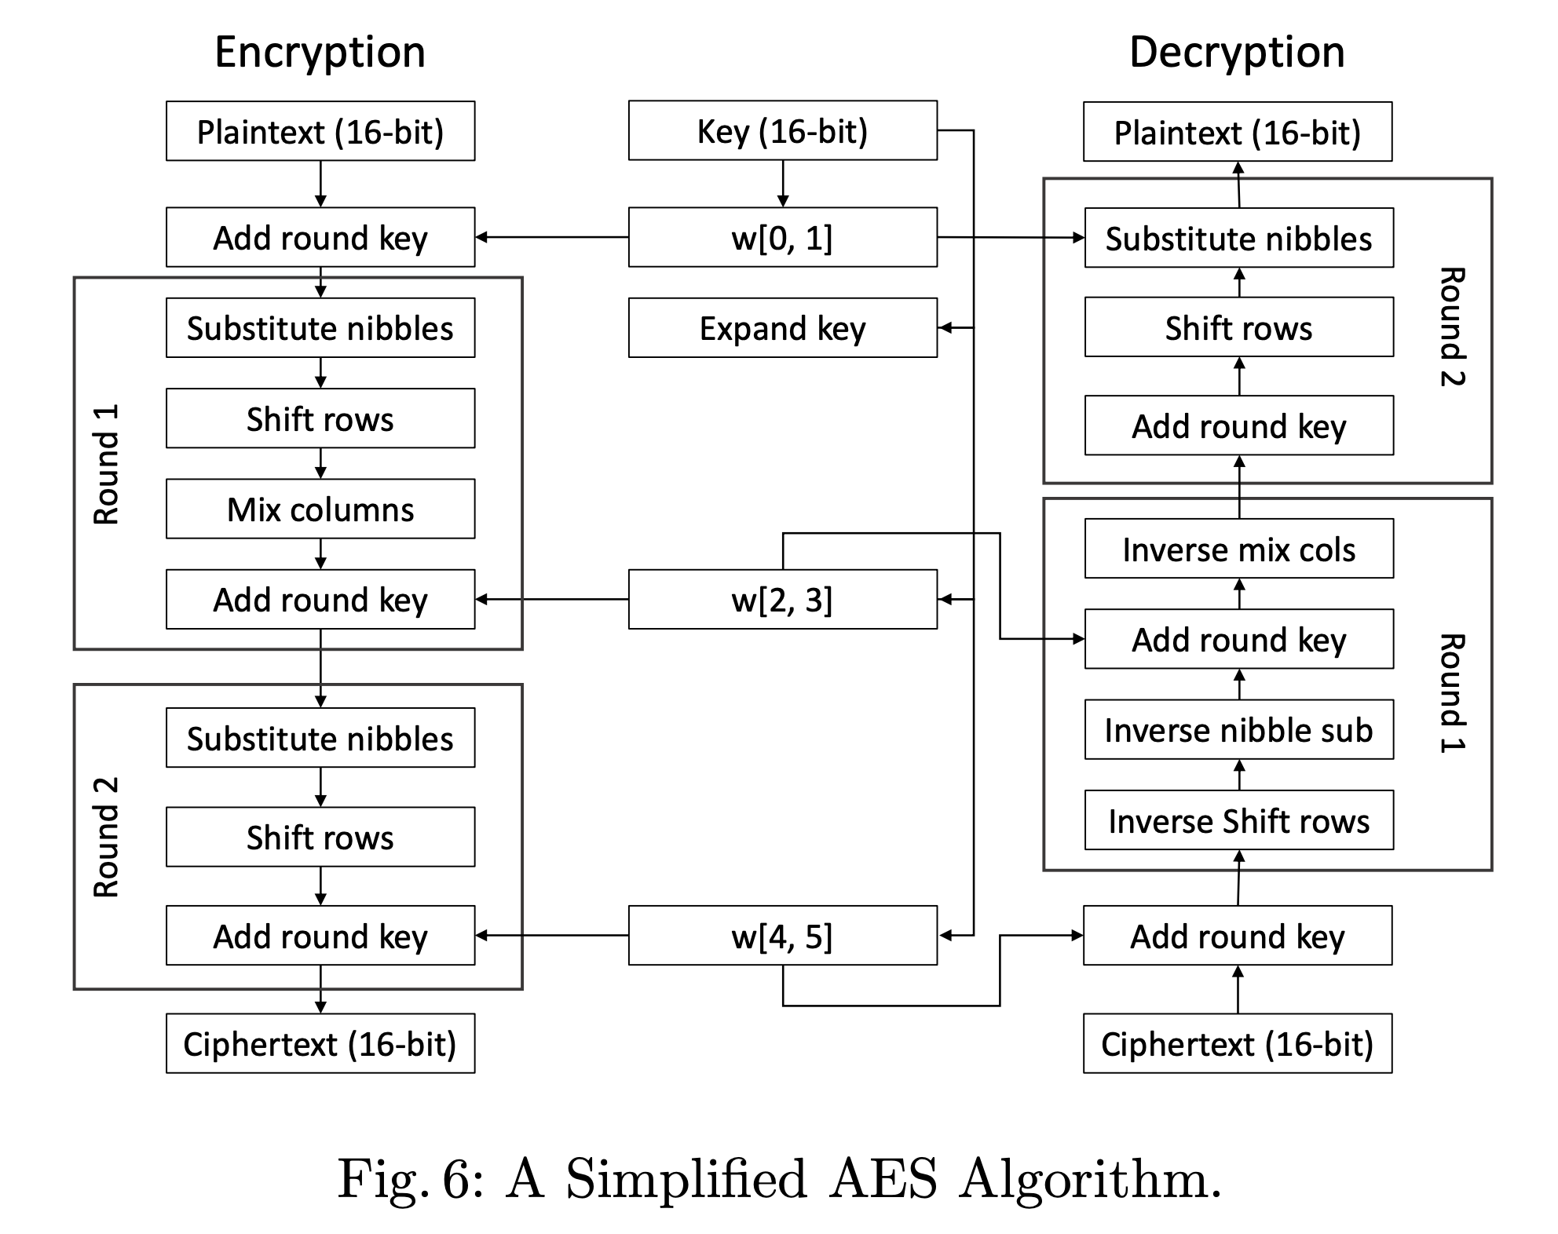
Target algorithms
Simple-DES, Simple-AES

Slide 13
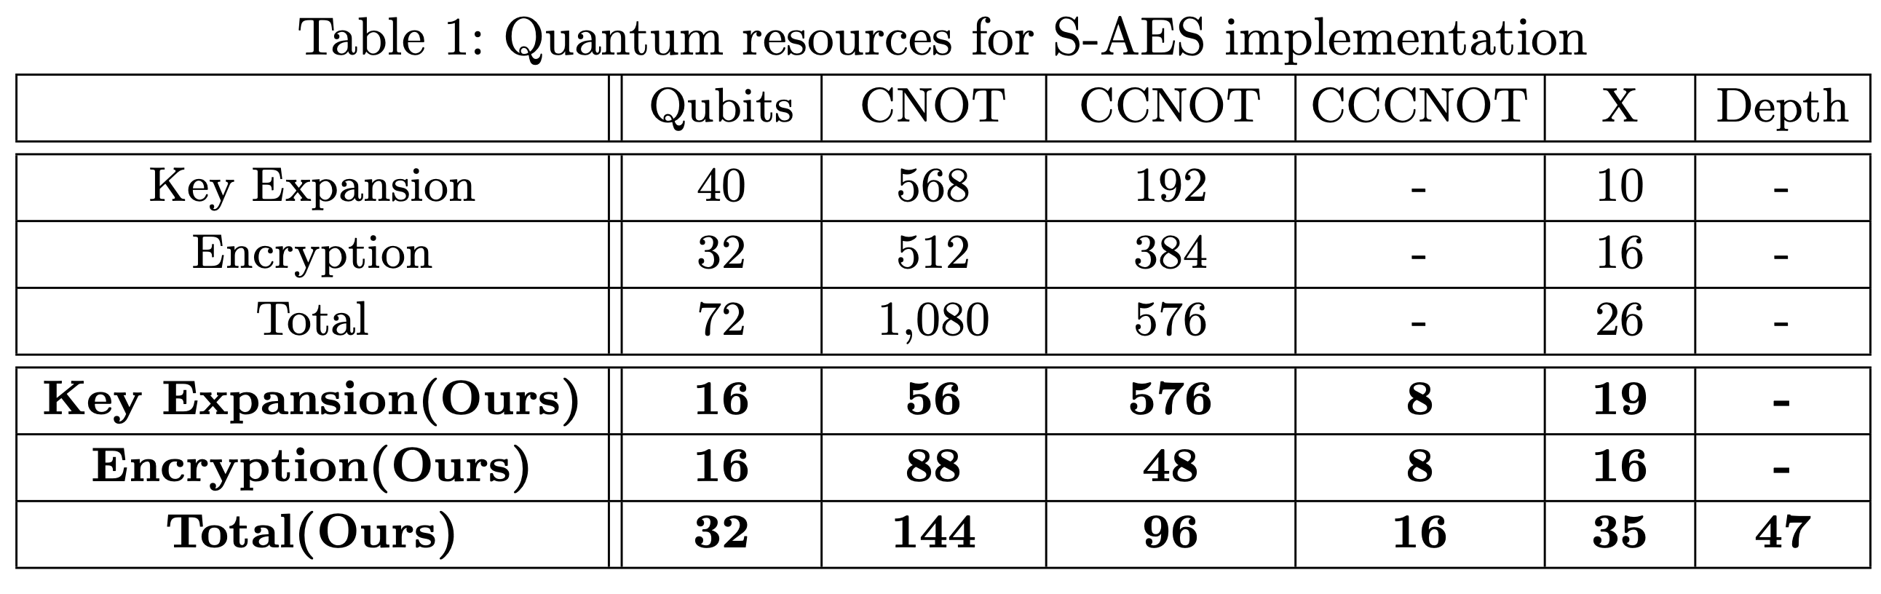
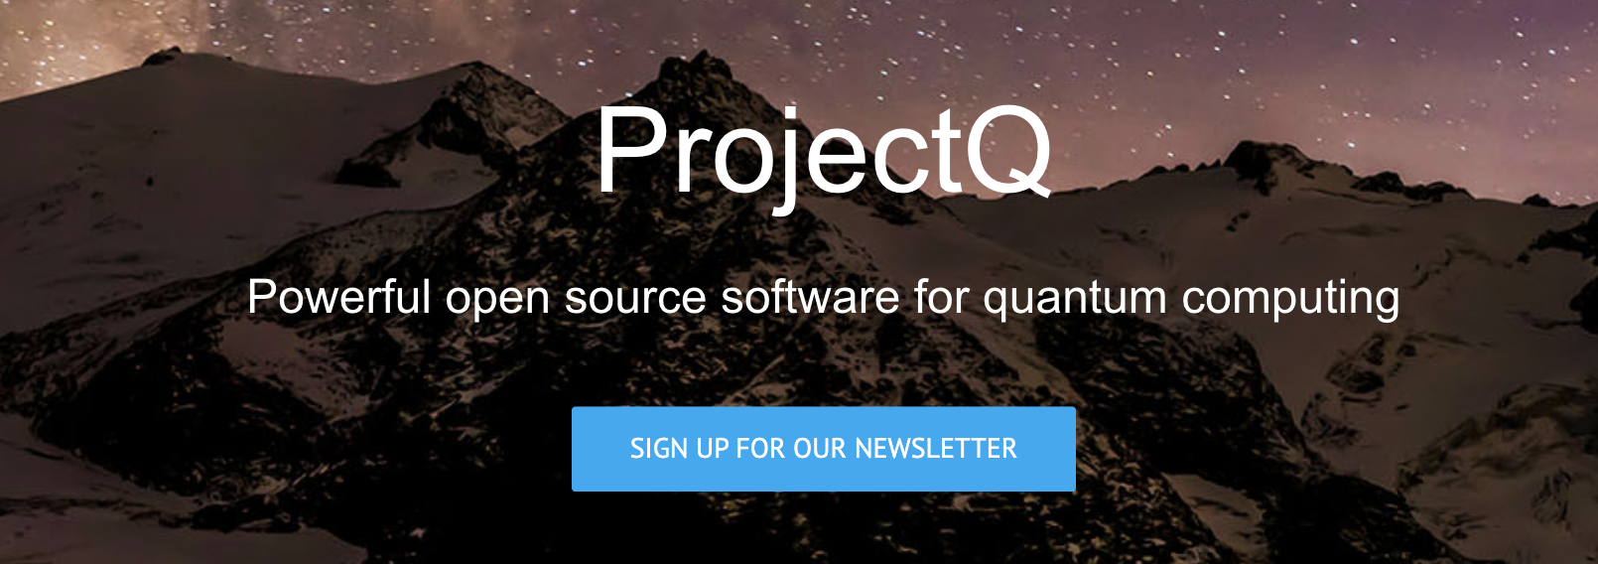
Target algorithms
Our Simple-AES quantum circuit design is dramatically optimized compared to the study results for Simple-AES
Reduced qubits by half than before
Reduced quantum gates and reduced depth than previous results.
Using more than 30 qubits was mostly limited in simulations, so we planned to take advantage of the IBM hub access provided during the hackathon.
ICSCA 2018: Proceedings of the 2018 7th International Conference on Software and Computer ApplicationsFebruary 2018 Pages 204–211https://doi.org/10.1145/3185089.3185122

Slide 14
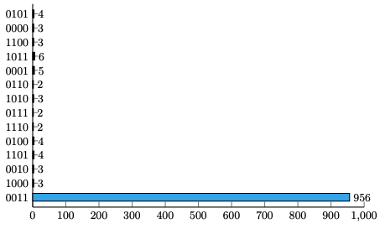
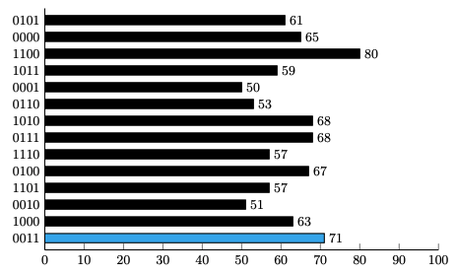
Results
Quantum key search on Caesar
Qubit : 13-qubit
Plaintext – Ciphertext : 0x2F – 0x52
Target Key Value : 0x3
Caesar Simulation
Caesar Cloud

Slide 15
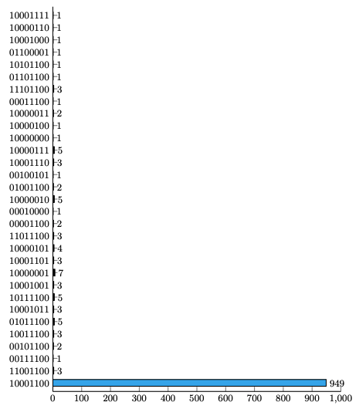
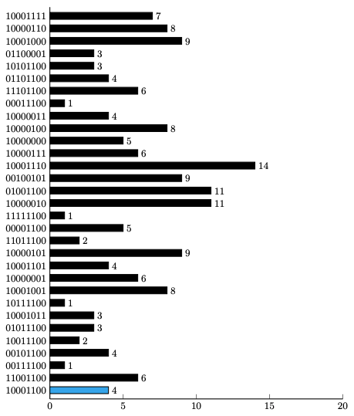
Results
Quantum key search on Caesar
Qubits : 17-qubit
Plaintext – Ciphertext : 0x42 – 0xCE
Target Key Value : 0x8C
Vigenere Simulation
Vigenere Cloud

Slide 16
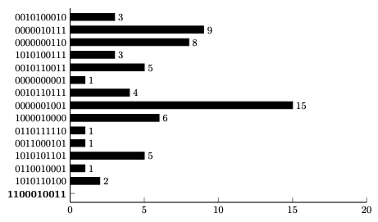
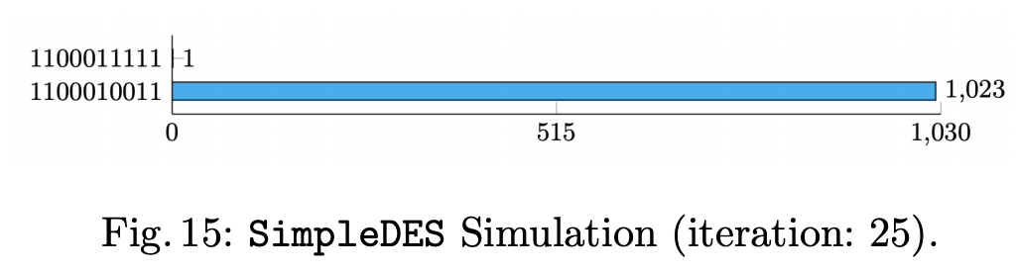
Results
Quantum key search on S-DES
Qubits : 18-qubit
Plaintext – Ciphertext : 0x10 – 0x33
Target Key Value : 1100010011
S-DES Simulation
S-DES Cloud

Slide 17
Conclusion
Quantum key search using Grover's algorithm has been theoretically established.
As you can see from the Simulator results!
However, it is still difficult to control the error rate that occurs in the actual quantum processor.
There is a need for advances in algorithms or quantum processors that can control errors.
Fortunately, it's still safe from attacks on real quantum computers!
However, it is necessary to prepare (Ex.) NIST PQC Competition
V S

Slide 18
Thank you!

